Slide 1

HI6050 Capstone: Comprehensive Topic Selection and Supplementary Document
Supervisor: Dr. Farshid Keivanian
Session 7: Preparation for Group Presentation and Demonstration

Slide 2
Session 7’s outline
1. Weekly Task Breakdown & Milestones
2. Preparation for Group Presentation and Demonstration
3. Group Progress Presentation – Overview of Progress at least 2 min

Slide 3
Weekly Task Breakdown & Milestones
Week | Action
Week 1-2 | Form groups, confirm your campus group number, select topic via Blackboard sheet.
Week 3 | Begin literature review + define project scope and research question.
Week 4 | Finalize tools, datasets, programming language; create basic prototypes/mockups.
Week 5 | Draft your research proposal + submit it.
Week 6 | Submit Research Proposal (25%)
Week 7-10 | Start project build (coding/analysis), write sections of final report.
Week 11 | Submit Final Report (45%)
Week 12 | Present & Demo Project (30%)

Slide 4
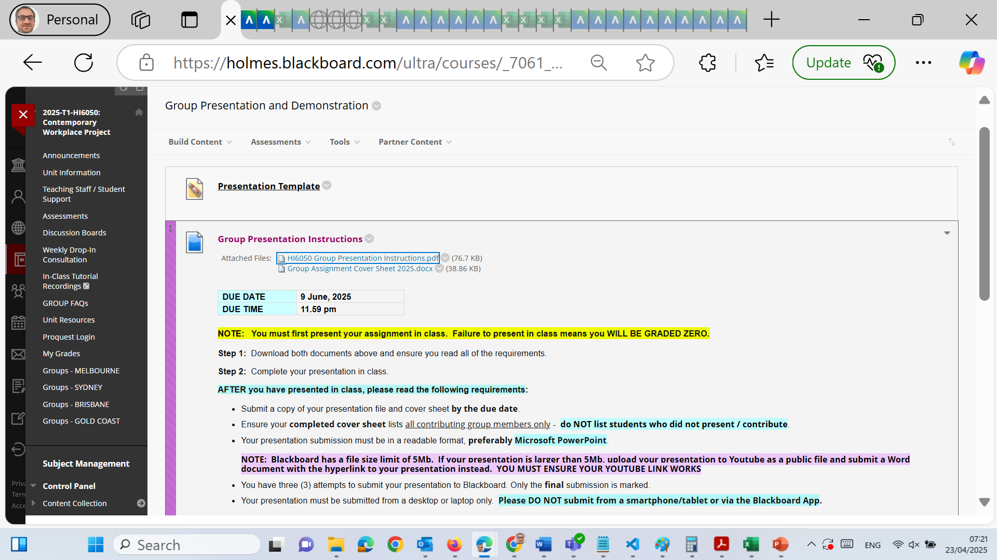
Preparation for Group Presentation and Demonstration

Slide 5
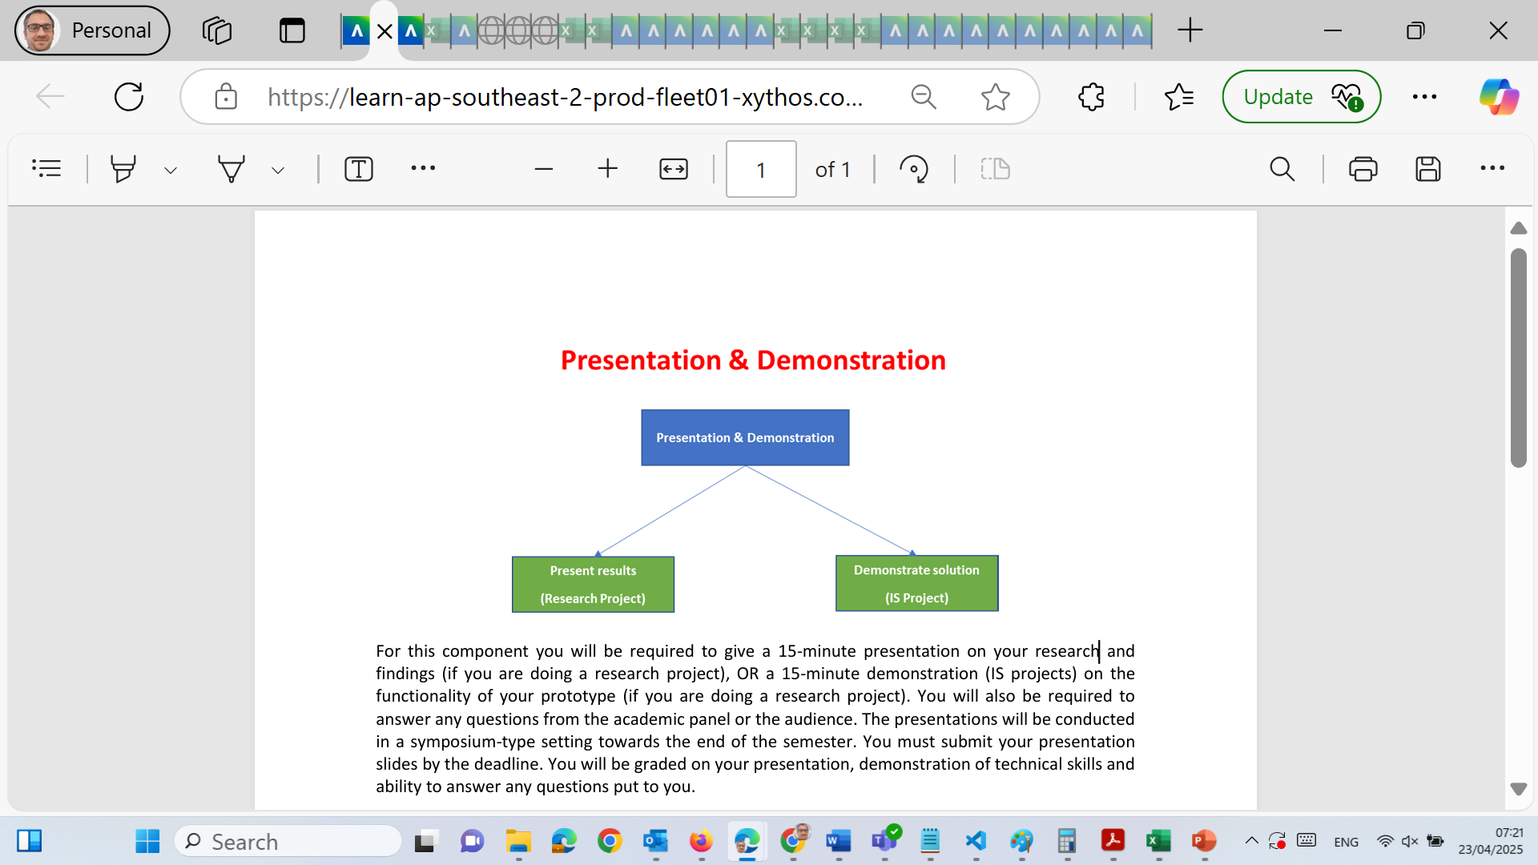
Preparation for Group Presentation and Demonstration

Slide 6
Preparation for Group Presentation and Demonstration
Group Presentation & Demonstration – Final Assessment Guide
Due Date: 9 June 2025 Presentation Time: In-class (as scheduled) Submission Deadline (Slides + Cover Sheet): 11:59 PM on 9 June 2025 Submission Format: Microsoft PowerPoint (.pptx) or YouTube link (if >5MB) + Cover Sheet Mandatory: All group members must present. Students not presenting = zero marks.

Slide 7
Preparation for Group Presentation and Demonstration
Purpose of This Task
To evaluate your team’s ability to:
Clearly communicate research findings (for research projects), OR
Demonstrate system functionality (for IS/prototype-based projects) It assesses technical understanding, communication skills, and teamwork.

Slide 8
Preparation for Group Presentation and Demonstration
What You Must Do
Step-by-Step Instructions:
Before Presentation (Preparation Phase)
Complete your project (IS prototype or research findings).
Design your presentation based on your project type:
Research Project: Present research aim, method, key findings, significance.
IS Project: Demo interface, features, database integration, workflows.

Slide 9
Preparation for Group Presentation and Demonstration
Use:
PowerPoint (preferred) or YouTube (if >5MB).
Professional design: Consistent fonts, clear graphs, minimal text.
Rehearse as a group.
Time limit: 15 minutes
Practice transitions and answering audience questions.
List only the students who presented on the cover sheet.

Slide 10
Preparation for Group Presentation and Demonstration
On Presentation Day
Be present in class – no remote presentation accepted unless pre-approved.
Bring a working version of your demo or slides on a USB or shared link.
Be prepared for live questions from lecturers/panel.

Slide 11
Preparation for Group Presentation and Demonstration
After Presentation (Submission Phase)
Upload:
PowerPoint file OR YouTube link in a Word file.
Completed cover sheet with names of those who presented.
Submit via Blackboard (desktop only, not from a phone/tablet).
Ensure YouTube links are public & working before uploading.

Slide 12
Preparation for Group Presentation and Demonstration
❌ What to Avoid
Mistake | Consequence
❌ Not presenting in class | Zero marks
❌ Using a PDF or Google Slides | Not accepted
❌ Submitting from a phone or tablet | Submission may not be received
❌ Listing non-presenting members on cover | Academic misconduct + no marks
❌ Unformatted cover sheet or missing names | Those students won’t receive marks
❌ YouTube links not working | File treated as missing

Slide 13
Preparation for Group Presentation and Demonstration
Tips for Success
Content Tips
For Research Project:
Use clear structure: Background → Methodology → Key Findings → Conclusion
Use tables, citations, and charts.
End with 1–2 slides: What next? Recommendations?
For IS/IT Projects:
Demo real functionality: logins, records, automation.
Have sample data in your system.
Ensure smooth navigation between modules.
Back up your source files before the day.

Slide 14
Preparation for Group Presentation and Demonstration
Presentation Tips
Use cue cards or speaker notes.
Stick to your part. Speak confidently but briefly.
Use transitions and let everyone speak ~2–3 mins each.
Expect questions like:
“How did your system solve the problem?”
“What was your biggest technical challenge?”

Slide 15
Preparation for Group Presentation and Demonstration
Final Submission Checklist
PowerPoint file OR YouTube link in Word
Microsoft Word Cover Sheet with names of actual presenters
Submitted before 11:59 PM, 9 June 2025
File format = .pptx or .docx only
File <5MB OR YouTube link submitted properly
Submitted from a desktop or laptop (not mobile)

Slide 16
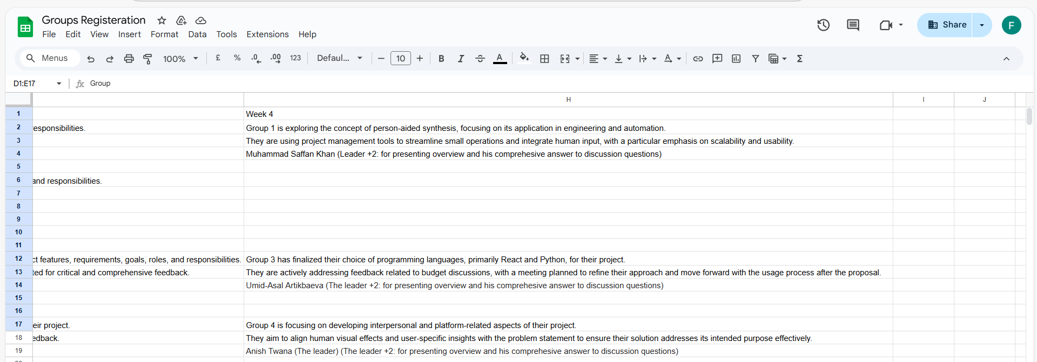
Group Progress Presentation – Overview of Progress at least 2 min

Slide 17
Thank You
Need Help? Send an email or ask during the tutorial session.
Good luck with your capstone journey!
Dr. Farshid Keivanian Capstone Project Supervisor farshid.keivanian@holmes.edu.au

